Slide 1
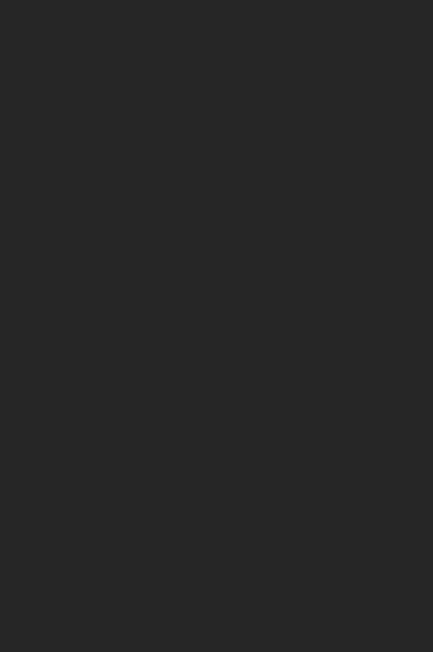
Image Processing
Computer Vision
Professor Luca Lombardi
Sepideh hayati

Slide 2
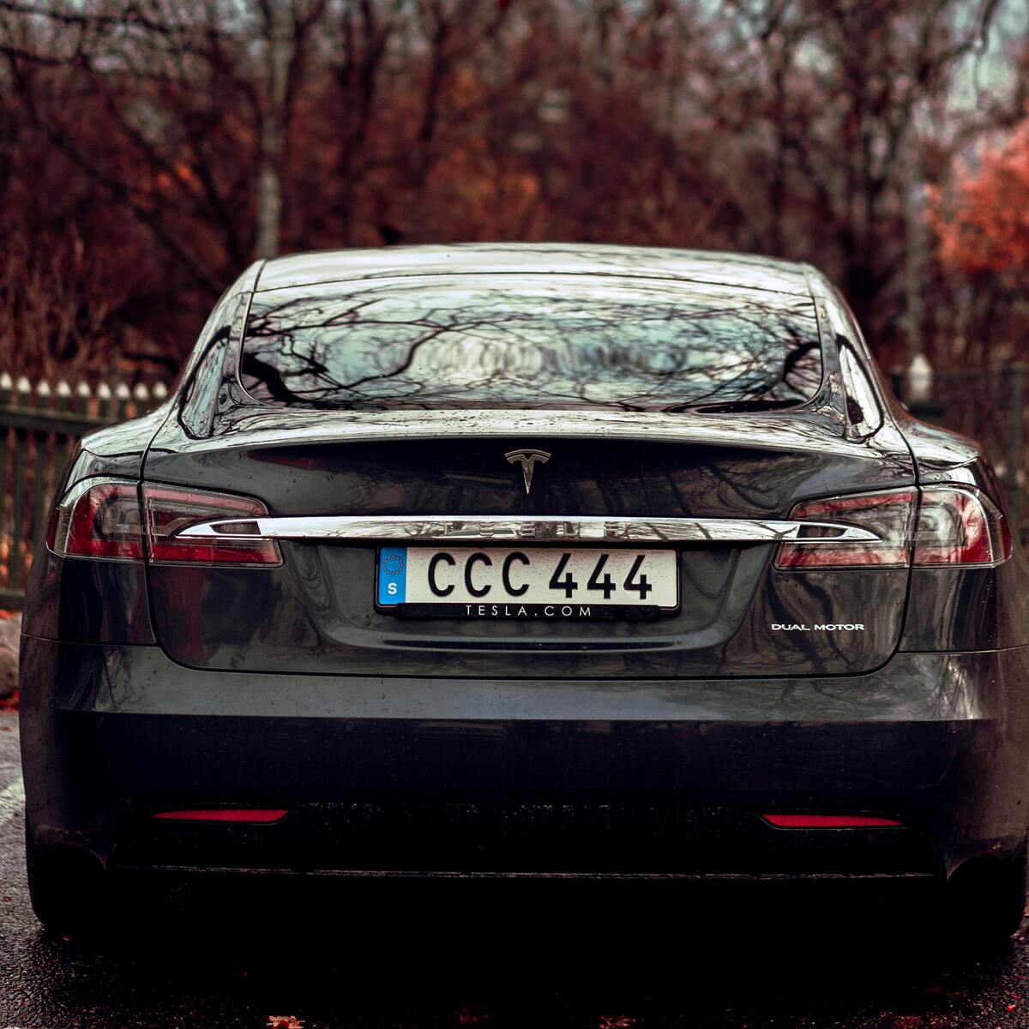
IMAGE PROCESSING
Using OCR
In Python

Slide 3
Image processing and OCR The project aims to identify and read license plate numbers and characters automatically
Using python

Slide 4
1.Select the Picture
We have selected an image that shows a car with a license plate.

Slide 5
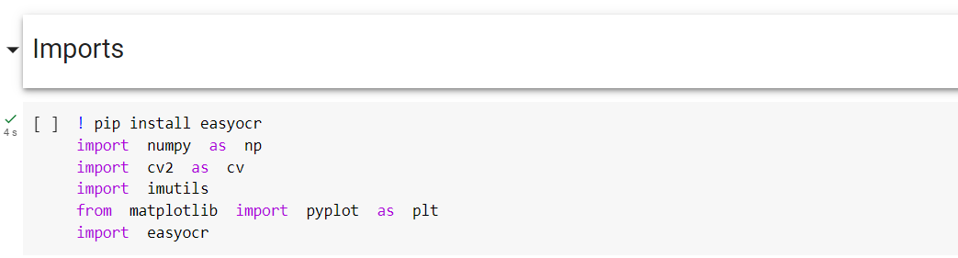
2.Import
we installed “EasyOCR”.
Then we Import “numpy” for working with arrays and data science operations.
Third line imports the "OpenCV" library used for image and video processing.
Next, we import the "Imutils" library, which provides helper functions for image processing.
Then we enter the pyplot function from the Matplotlib library, which is used to display images and draw graphs.
Then we import the EasyOCR module, which is used to recognize and read text from images.

Slide 6
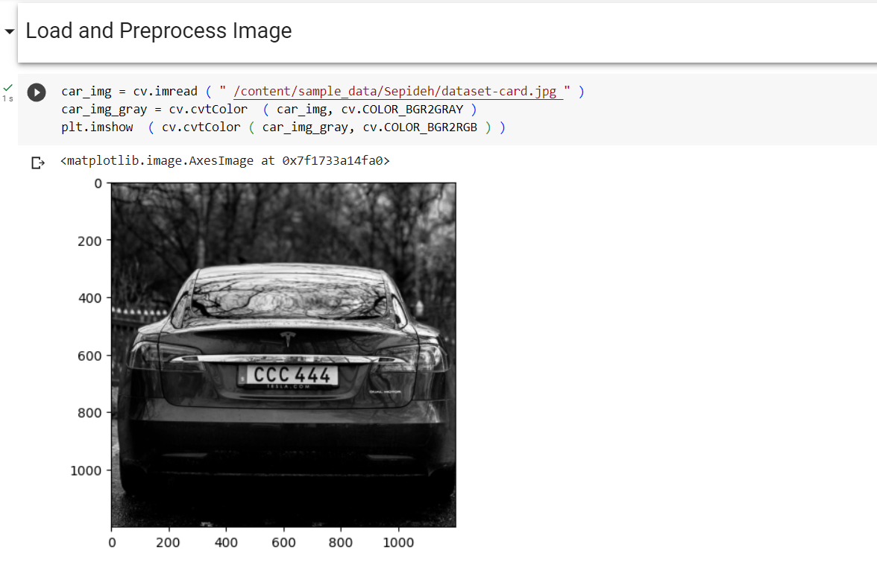
3. Load and preprocess Image
First line: This code loads the car image from the specified path and stores it in the car_img variable.
Second line: converts the image to grayscale using the cvtColor function and the COLOR_BGR2GRAY parameter.
Third line: This line displays the image using the imshow function of Matplotlib.

Slide 7
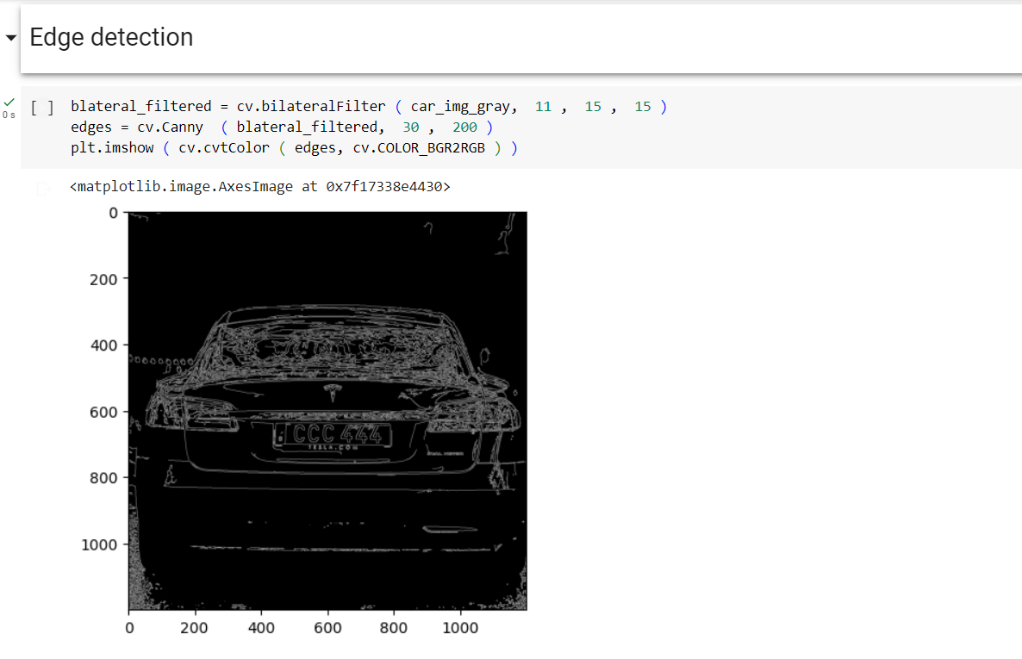
4. Edge Detection
First line: filters the gray image using a bilateral filter.
Second line: detects the edges of the image using the Canny algorithm.
Third line: displays the detected edges using the imshow function from the pyplot library..
Notes:
A bilateral filter is a filtering technique used in image processing. It is specifically designed to reduce noise in an image while preserving the edges and boundaries between different regions. In summary, the bilateral filter is an effective method for noise reduction and improving image quality. The Canny algorithm is a popular edge detection technique used in image processing. It aims to identify the edges or boundaries between different objects or regions within an image.

Slide 8
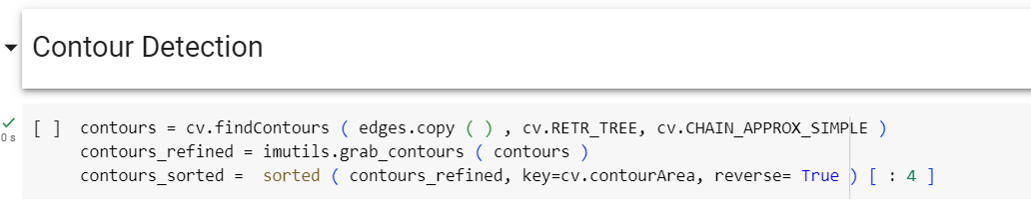
5. Contour Detection
First line: takes the detected edges as input using the findContours function of OpenCV and returns all contour vertices.
Second line: receives a list of contours from the output of the findContours function using the grab_contours function from the imutils module.
Third line: sorts the list of contours based on the area of each contour and selects the four contours with the largest area and stores them in the contours_sorted list.
Notes:
Contours are the closed and continuous curves of objects or regions within an image. Contours are formed based on changes in color intensity or light intensity in the image The findContours function in the OpenCV library is a common function for finding contours. This function takes an input image that contains the detected edges and identifies the contours present in the image, returning them as a list. the output of the findContours function consists of a list of contours. Each contour is represented as a list of points

Slide 9
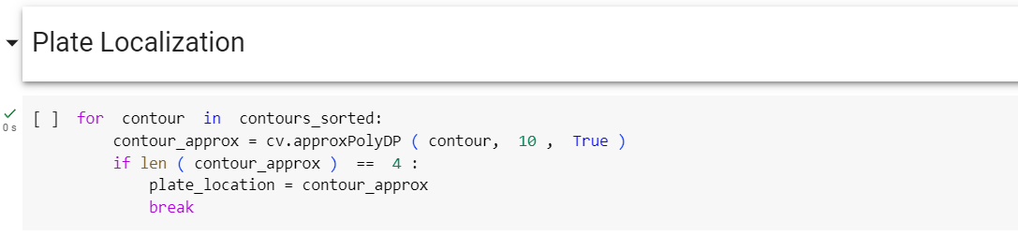
6. Plate Localization
First line: creates a for loop to do the following for each contour in contours_sorted:
Second line: creates a polygon approximation for the current counter using the approxPolyDP function from OpenCV.
Third-Fifth line: This condition checks that the number of approximated points is equal to 4. If the condition is true, it stores the location of the numbering plate with the name plate_location and exits the loop.
Notes:
It creates a for loop to iterate through each contour in the contours_sorted list. The approxPolyDP function approximates the contour shape with a simpler polygonal shape.
If the condition is met, it stores the location of the identified numbering plate with the name plate_location and exits the loop.

Slide 10
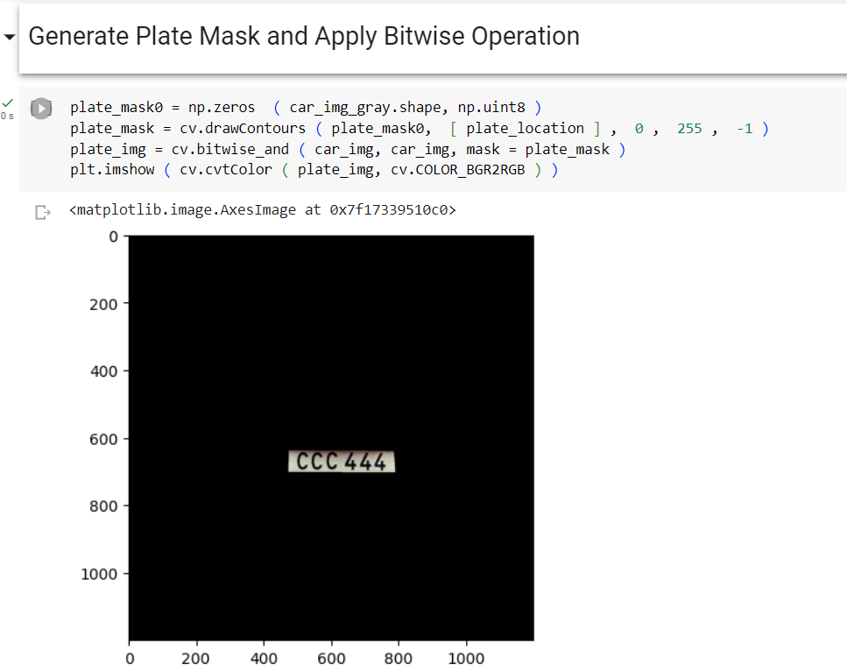
7.Generate Plate Mask
First line: creates an image with the same dimensions as car_img_gray with a pixel value of zero (black) and stores it in the plate_mask0 variable.
Second line: This line of code draws the plate_location contour on plate_mask0 using the drawContours function of OpenCV and makes the area inside the contour white.
Third line: Using the bitwise_and function of OpenCV, this line of code combines the original car_img image with the plate_mask image located on it based on the bitwise AND operator and stores the result in the plate_img variable.
Forth line: This line of code displays the plate_img image using the imshow function from the matplotlib library.
Notes:
First: In other words, plate_mask0 is initialized as an image of the same size as car_img_gray, but all the pixel values in plate_mask0 are set to zero, resulting in a completely black image. This can be useful for creating a binary mask
Second: now in this part we want to draw plate location contour that we have gain it from previous step, om plate mask. Using drawcontours function.

Slide 11
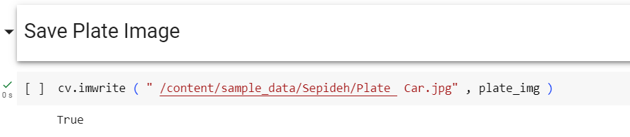
8.Save Plate Image
First line: This line of code saves the image plate_img in the desired path.

Slide 12
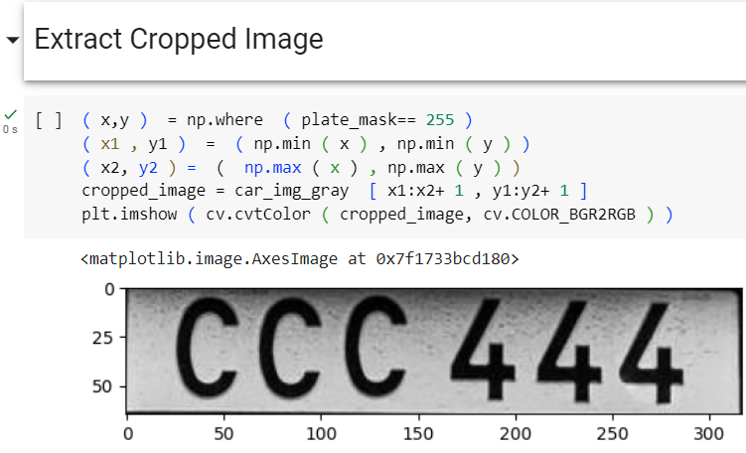
9. Extract Cropped Image
First line: extracts the row and column coordinates of white pixels (value 255) in plate_mask and stores them in x and y variables.
Second/ Third line: extracts the minimum/maximum row and column values from the set of x and y values and stores them in the x1/ x2 and y1/ y2 variables.
Forth line: This line of code stores the image of the desired part, extracted from car_img_gray using the previous coordinates, in the cropped_image variable.
Fifth line: displays the cropped_image image using the imshow function and converting from BGR to RGB color space.

Slide 13
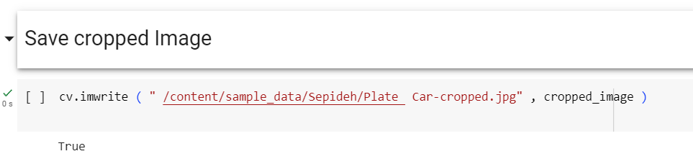
10. Save Cropped Image
This line of code saves the cropped_image image to the desired path.

Slide 14
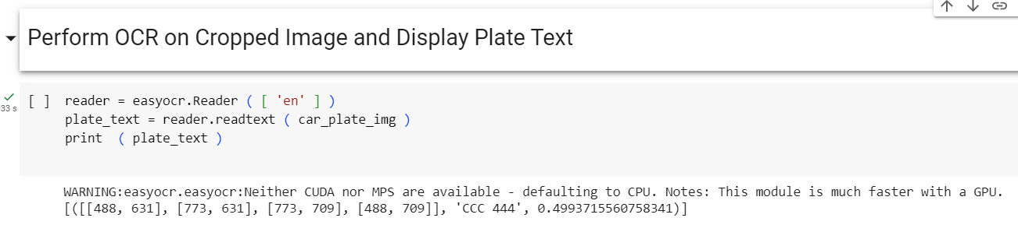
11. Preform OCR
First line: a Reader object is created and stored in the reader variable, configured to perform OCR with English language support.
Second line: detects the text in the car_plate_img image using the readtext function of the reader object and stores it in the plate_text variable.
Third line: prints the detected text on the output.

